Slide 1
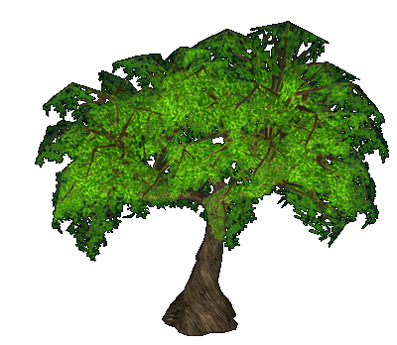

Decision Tree
DR Rani OOMMan Panicker

Slide 2
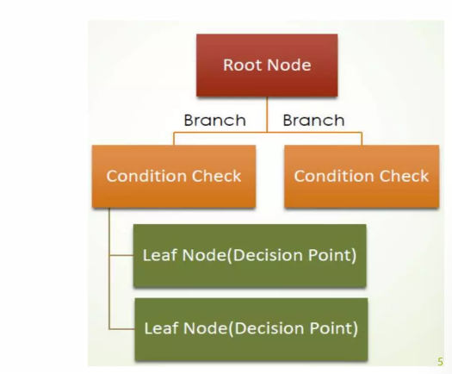
Decision Tree
Supervised learning technique
can be used for both classification and Regression problems, but mostly it is preferred for solving Classification problems.
Algorithm
(Decision Tree)
Dataset
Classification

Slide 3
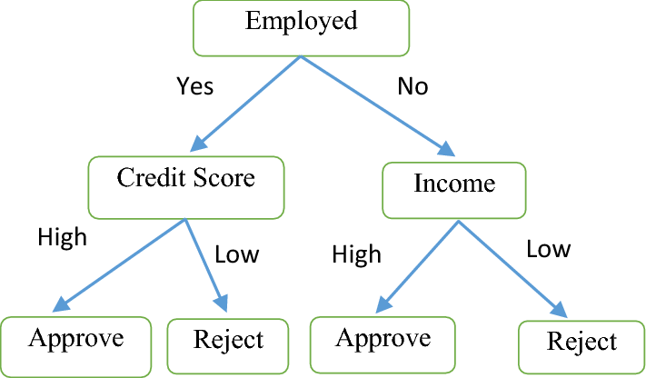
Loan approval or rejection
Nodes: an attribute (describes an instance
Branch: possible values of the attribute
Leaf: class

Slide 4
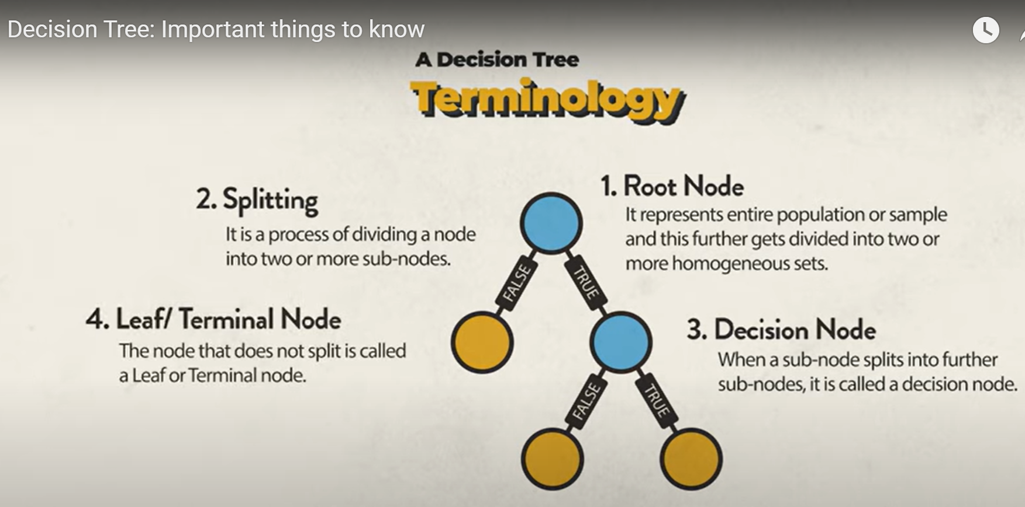

Slide 5
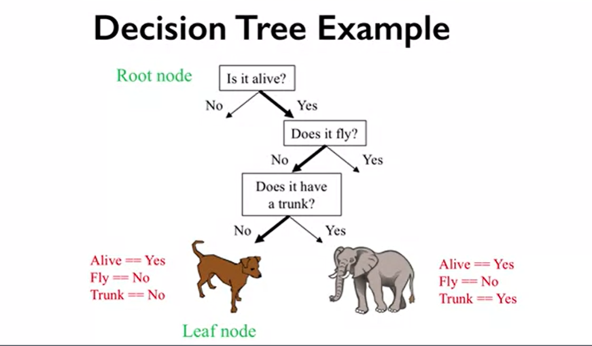

Slide 6
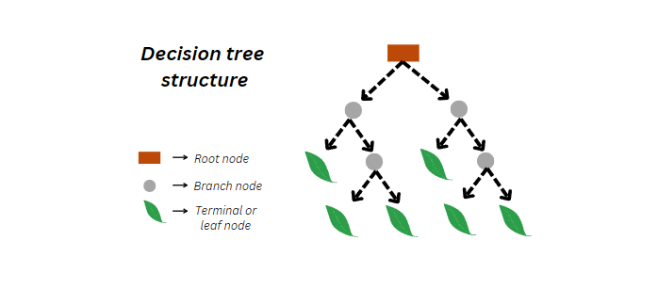
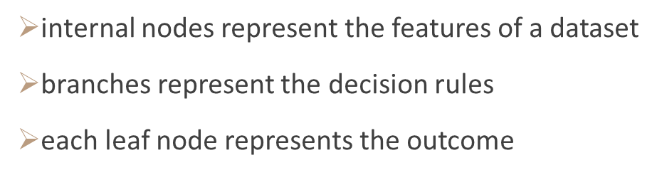
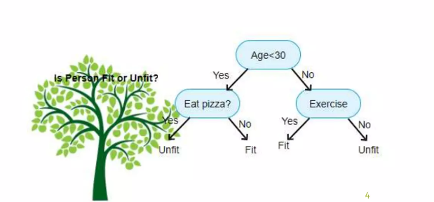

Slide 7
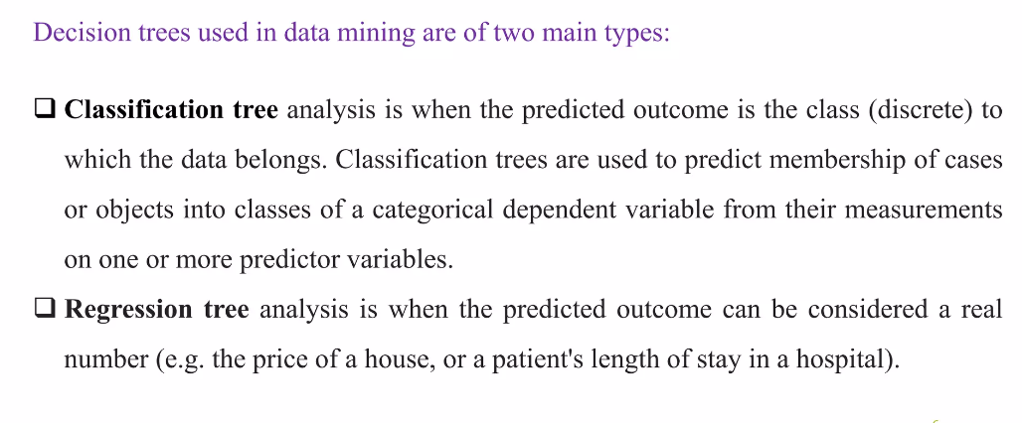
Decision Tree

Slide 8
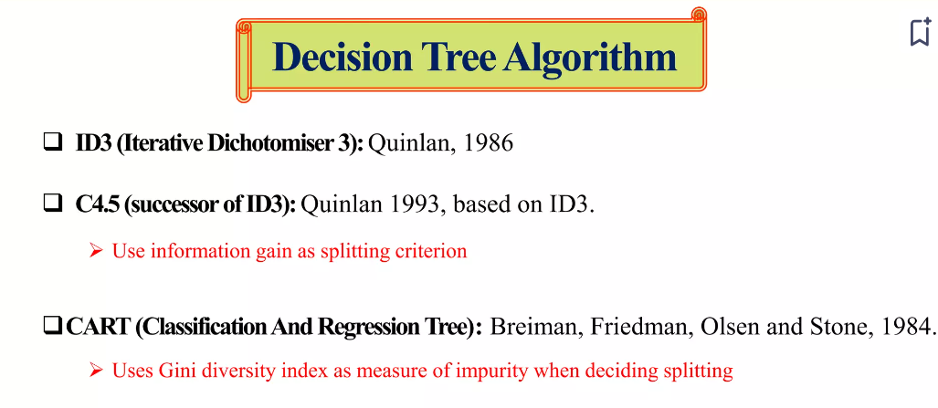
https://www.slideshare.net/MdAlAmin187/decision-tree-in-artificial-intelligence

Slide 9
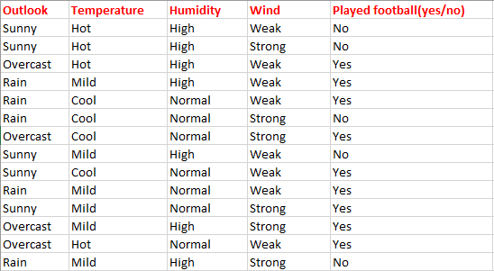
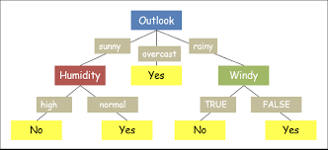
Data set

Slide 10
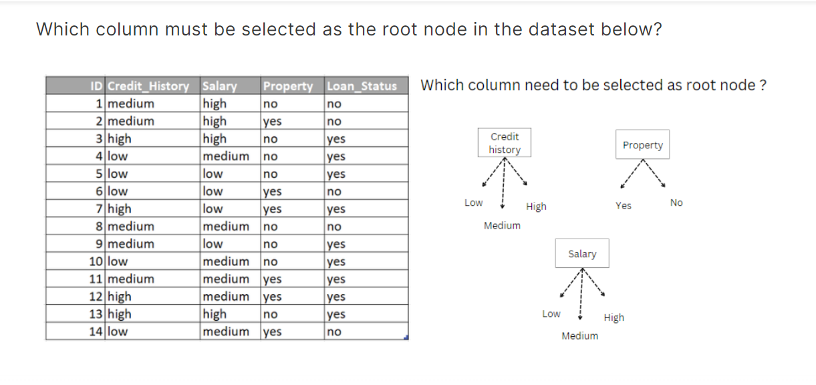

Slide 11
Decision of root node:
Gini index (CART algorithm)
Entropy and Information Gain (ID3)
The best attribute is the one with the highest information gain.

Slide 12
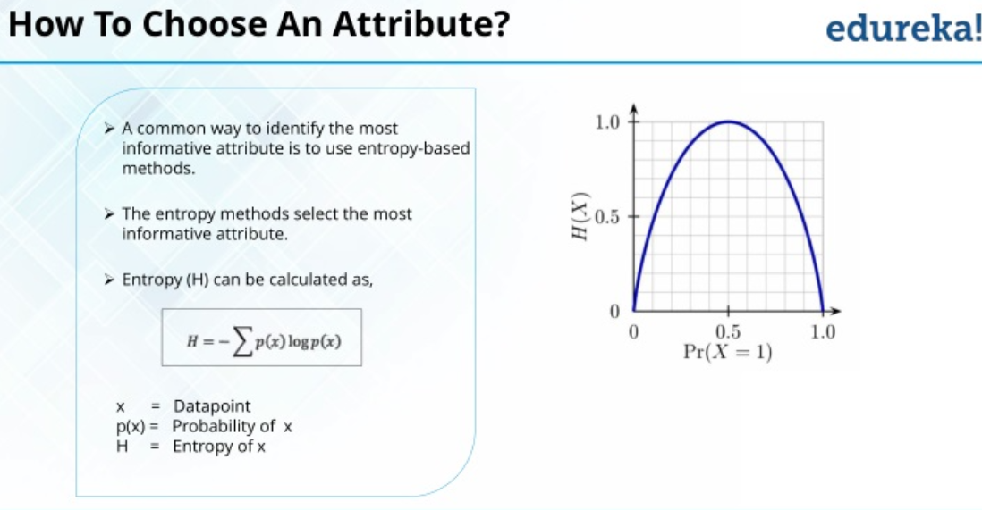
Entropy
Entropy is a common way to measure impurity

Slide 13
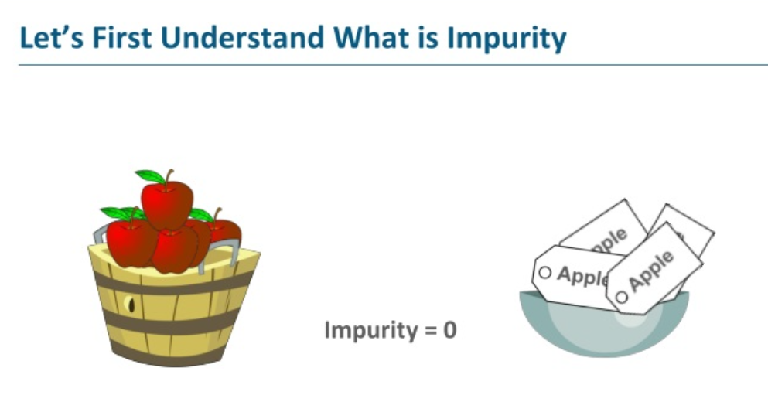
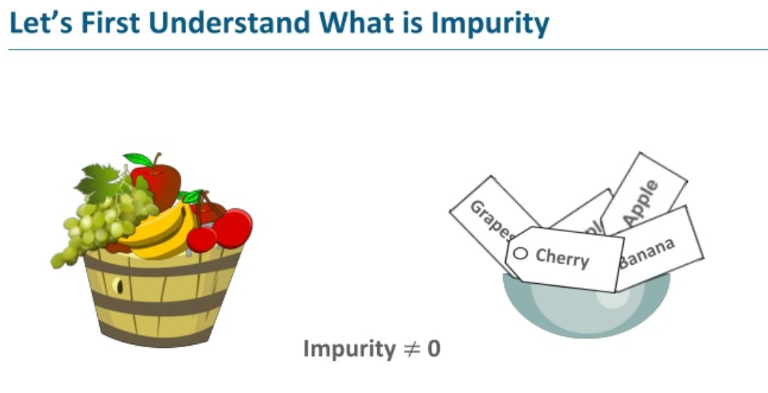

Slide 14
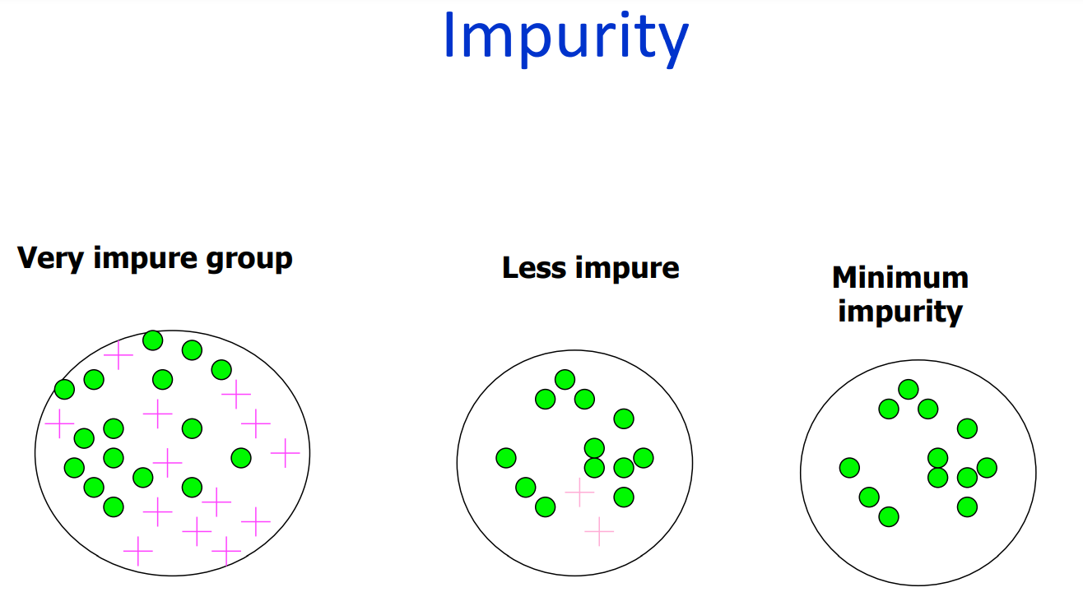

Slide 15
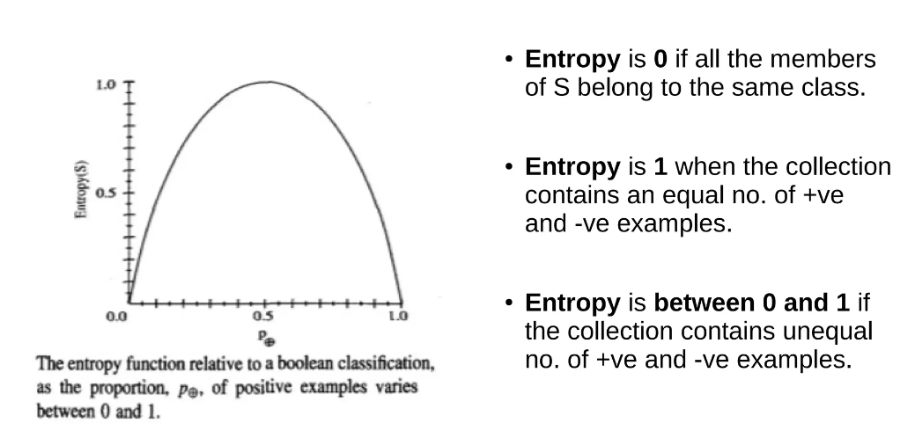
ID3 follows the rule — A branch with an entropy of zero is a leaf node and A branch with entropy more than zero needs further splitting.

Slide 16
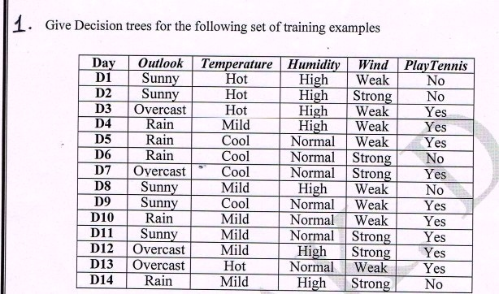
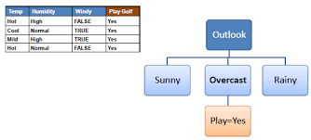

Slide 17
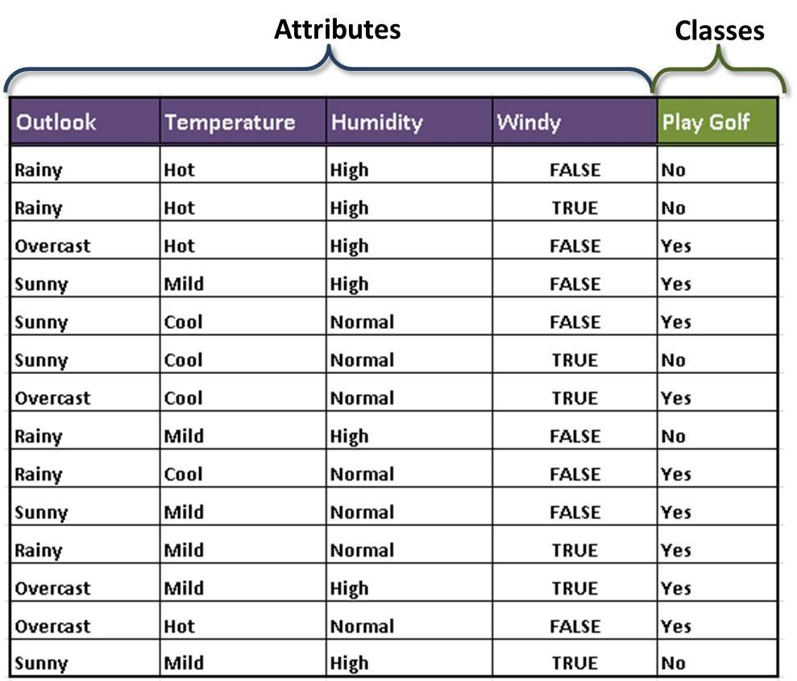
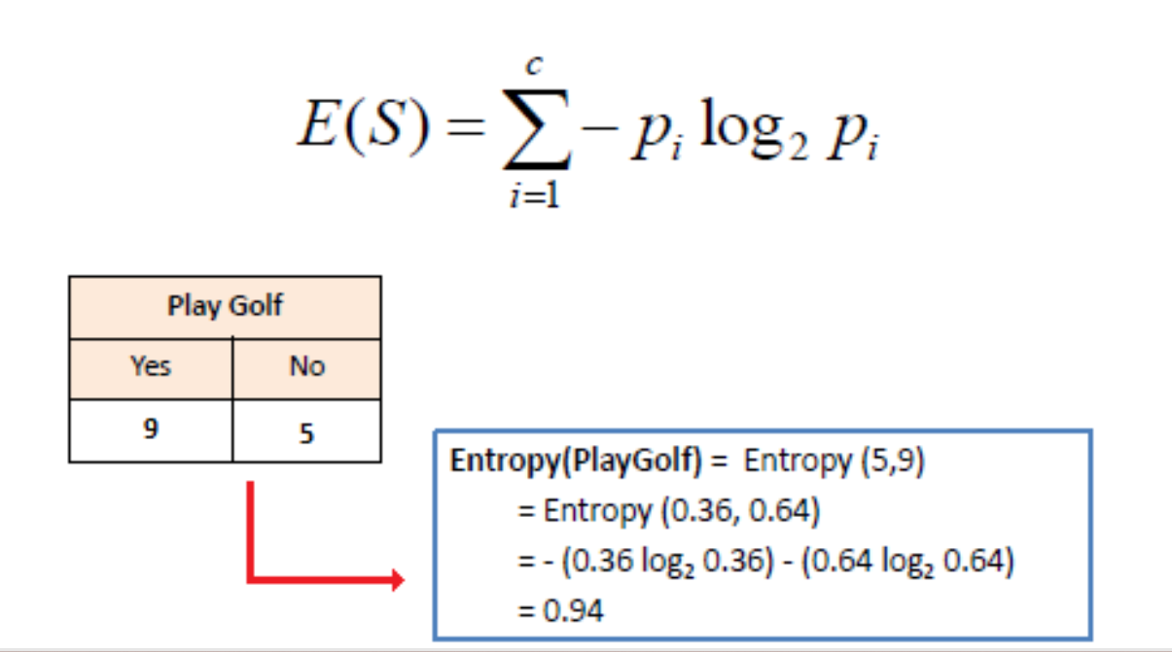
Total data set=14
P(yes)=9/14=0.64 and P(No)=5/14=0.36

Slide 18
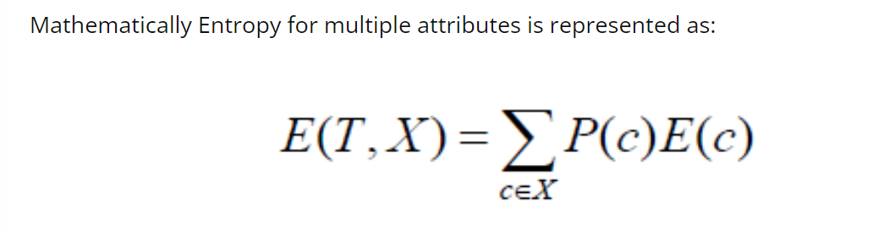

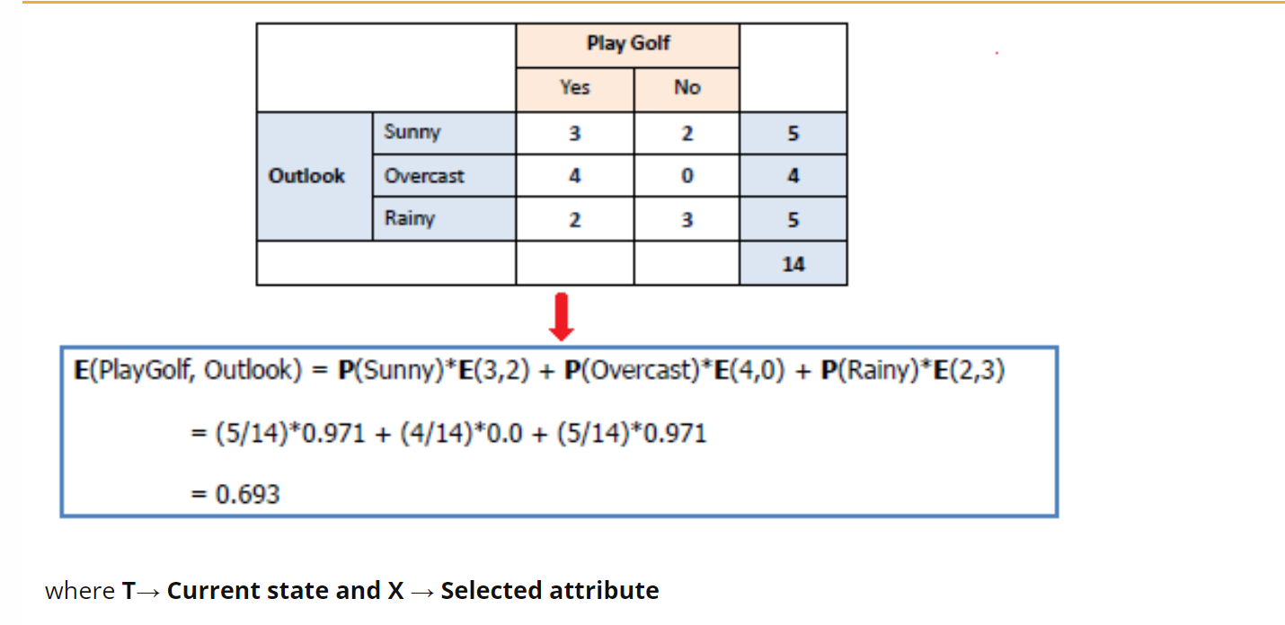

Slide 19
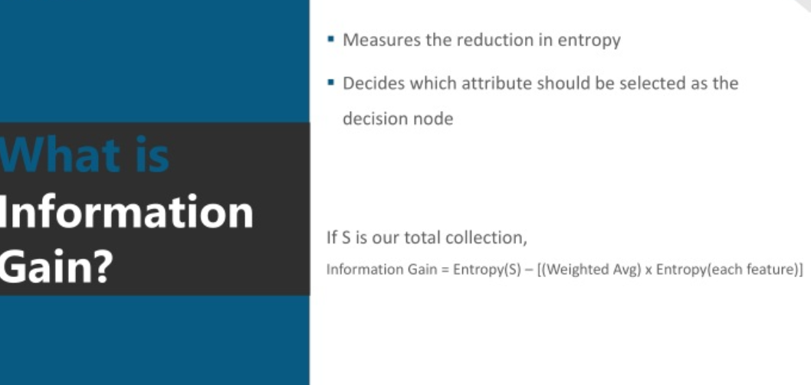

Slide 20
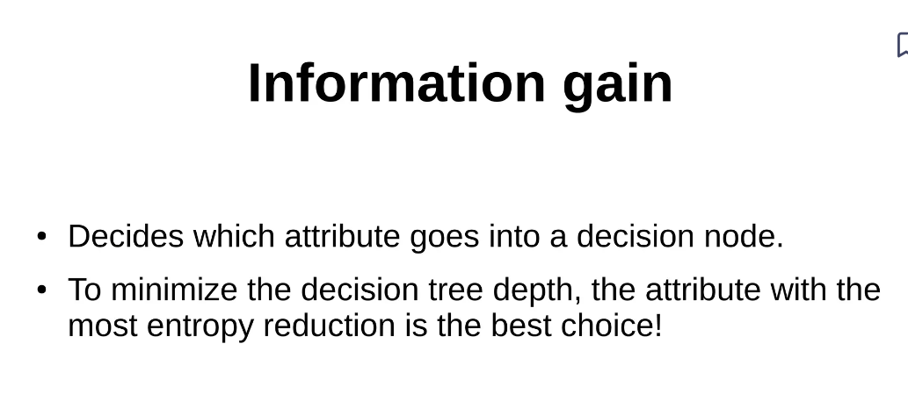

Slide 21
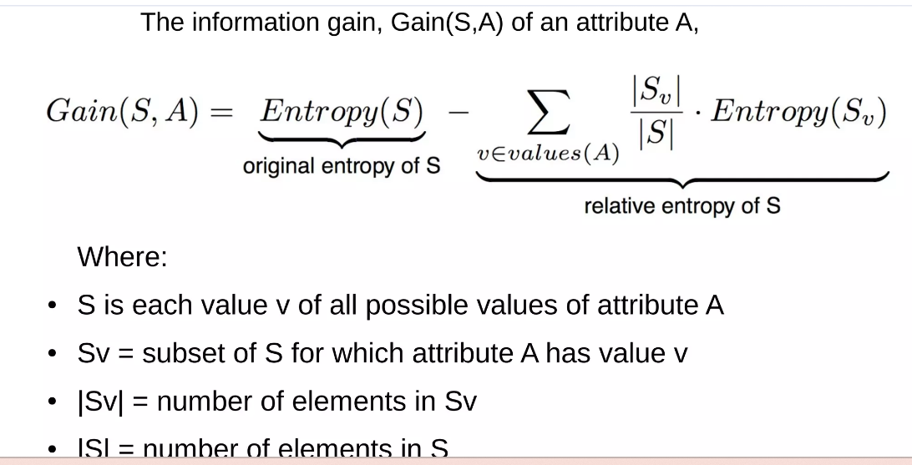

Slide 22
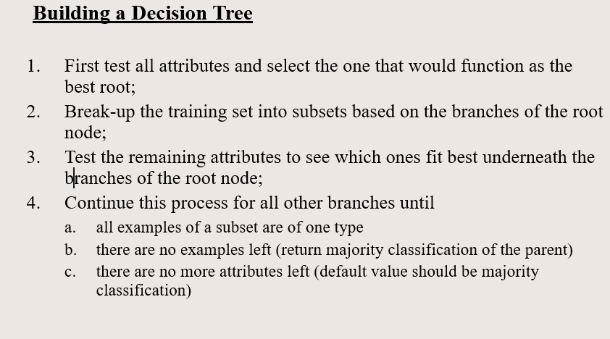

Slide 23
Algorithm steps
1. Choose the best feature as root node (based on entropy and information gain)
2.split the dataset
3.Repeat
4. Stop when the leaf nodes are pure.

Slide 24
Exam question (End sem)

Slide 26
gain
https://www.hackerearth.com/practice/machine-learning/machine-learning-algorithms/ml-decision-tree/tutorial/
https://www.analyticsvidhya.com/blog/2023/01/step-by-step-working-of-decision-tree-algorithm/

